Slide 1
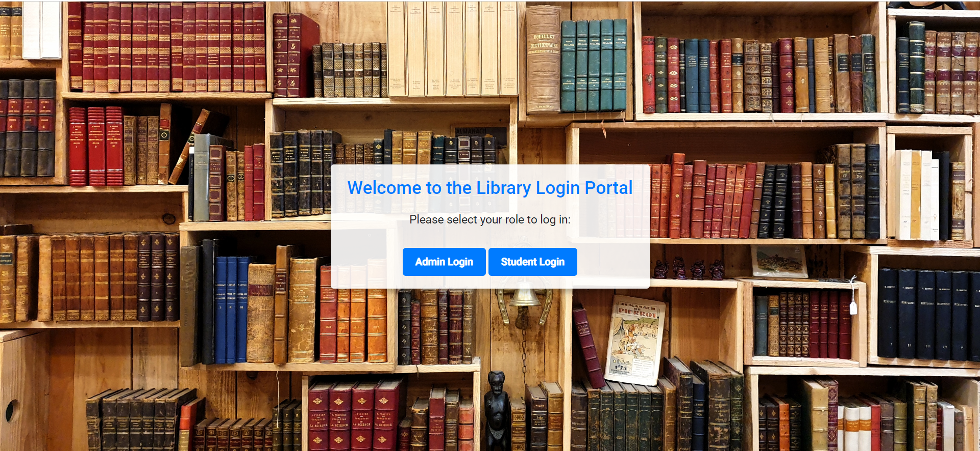
This is our landing Page, here we have options to

Slide 2
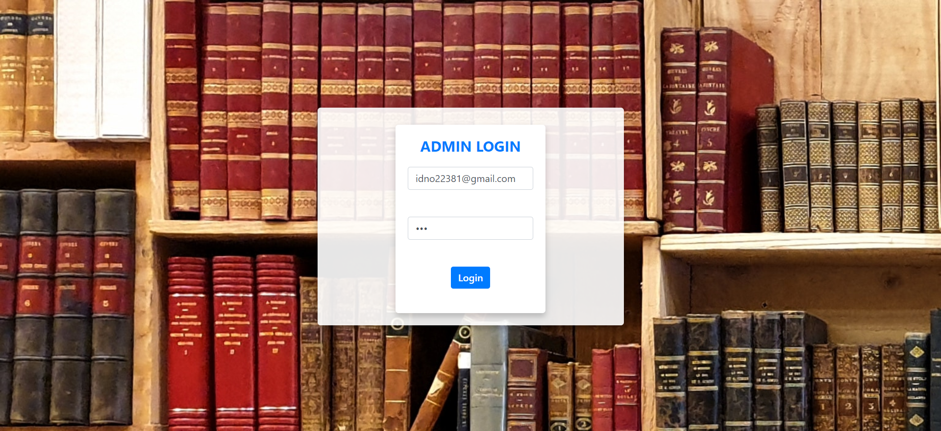
If we click on Admin login , admin page will open and here we have to fill the correct id and password otherwise it will revert us back to the landing page.

Slide 3
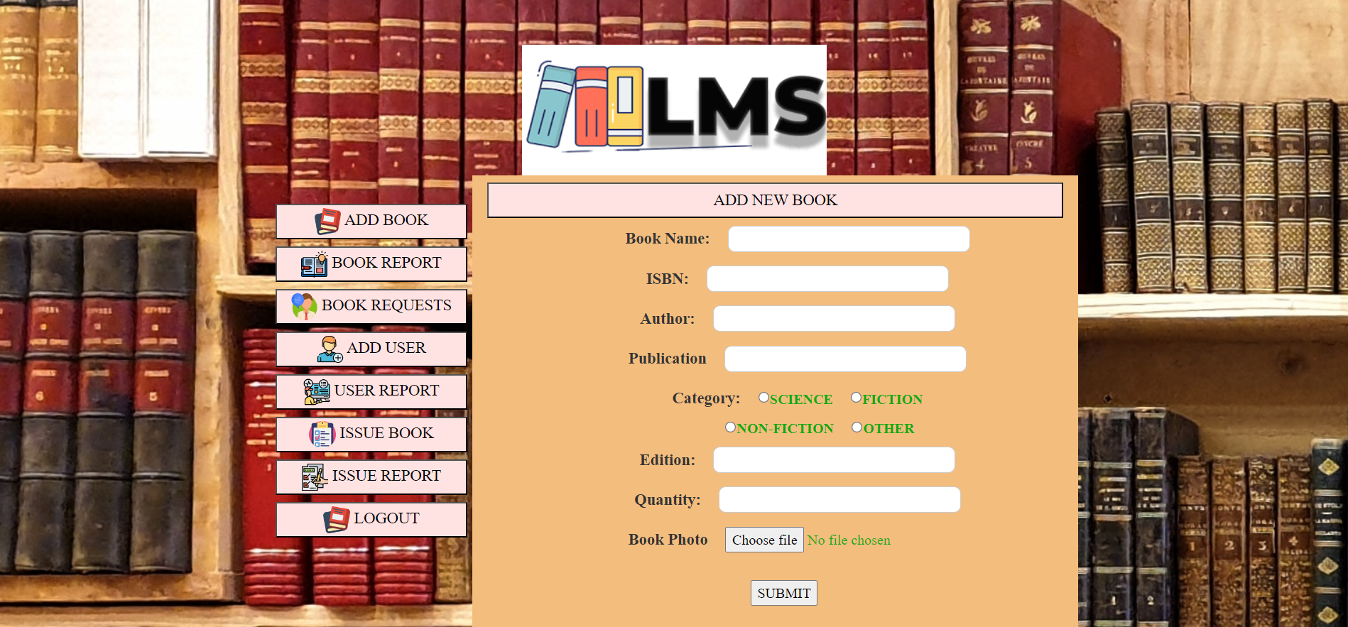
If Admin wants to add book then all the details mentioned below have to be filled and then click on SUBMIT button.

Slide 4
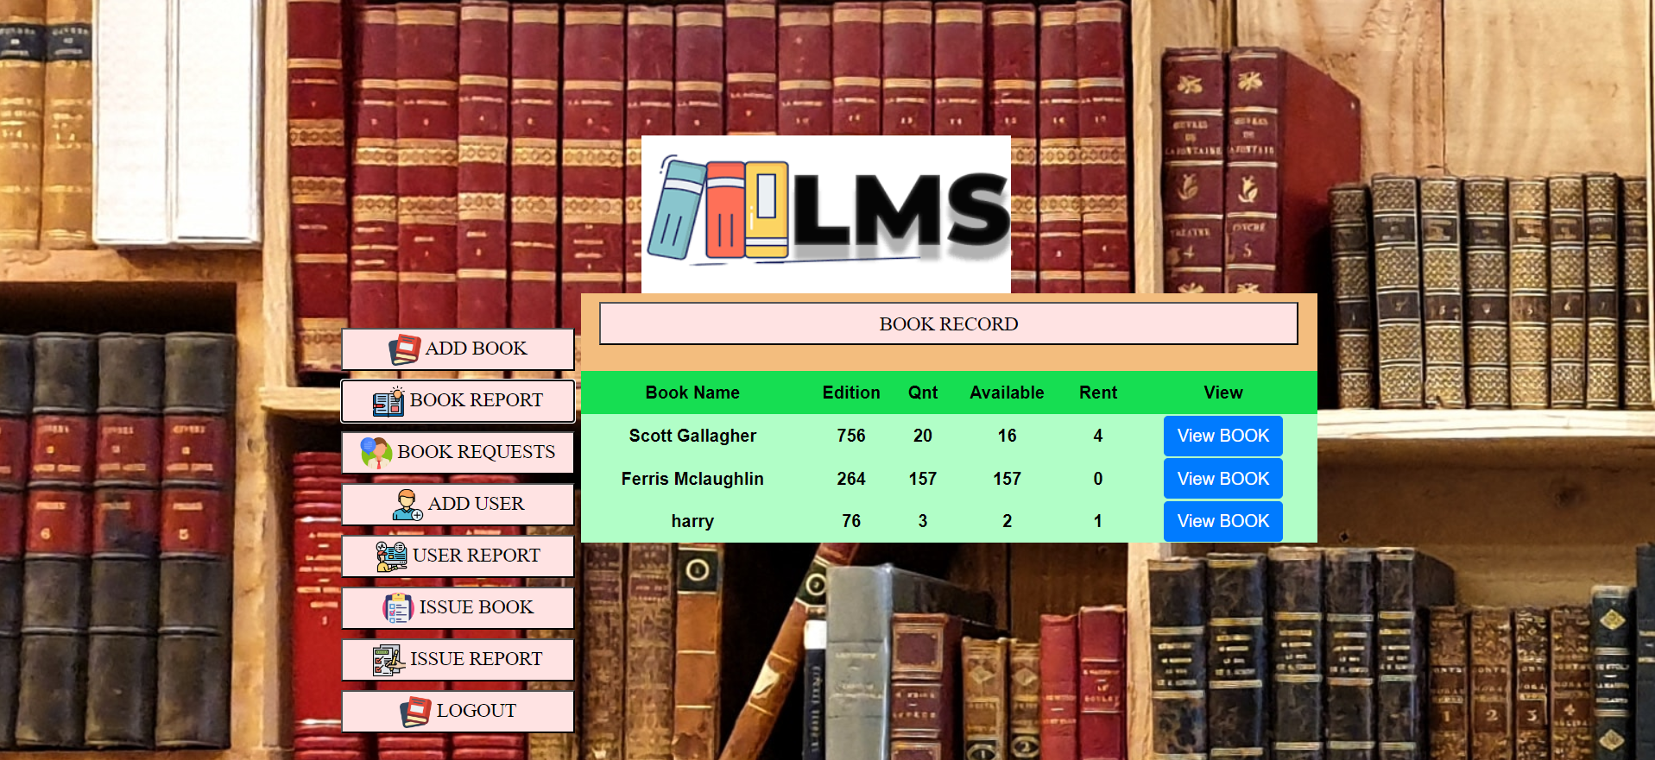
When we click on Book report

Slide 5
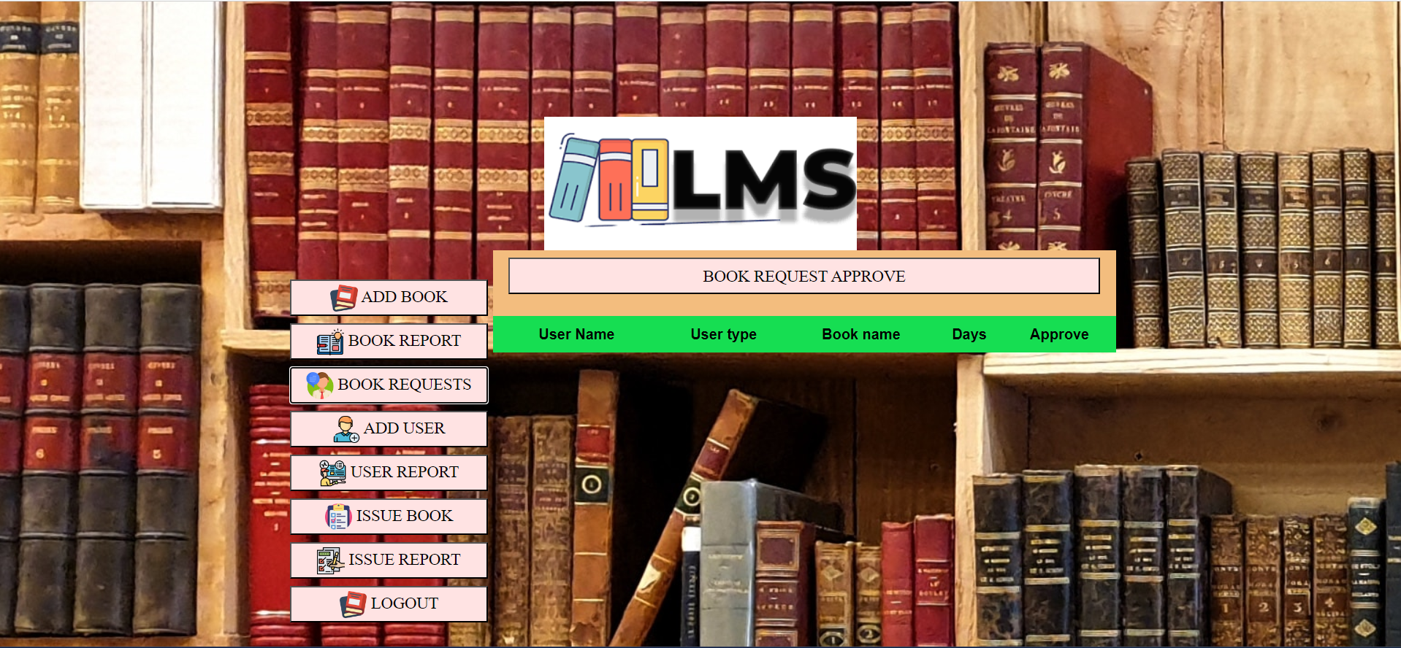
When we clicks on Book requests

Slide 6
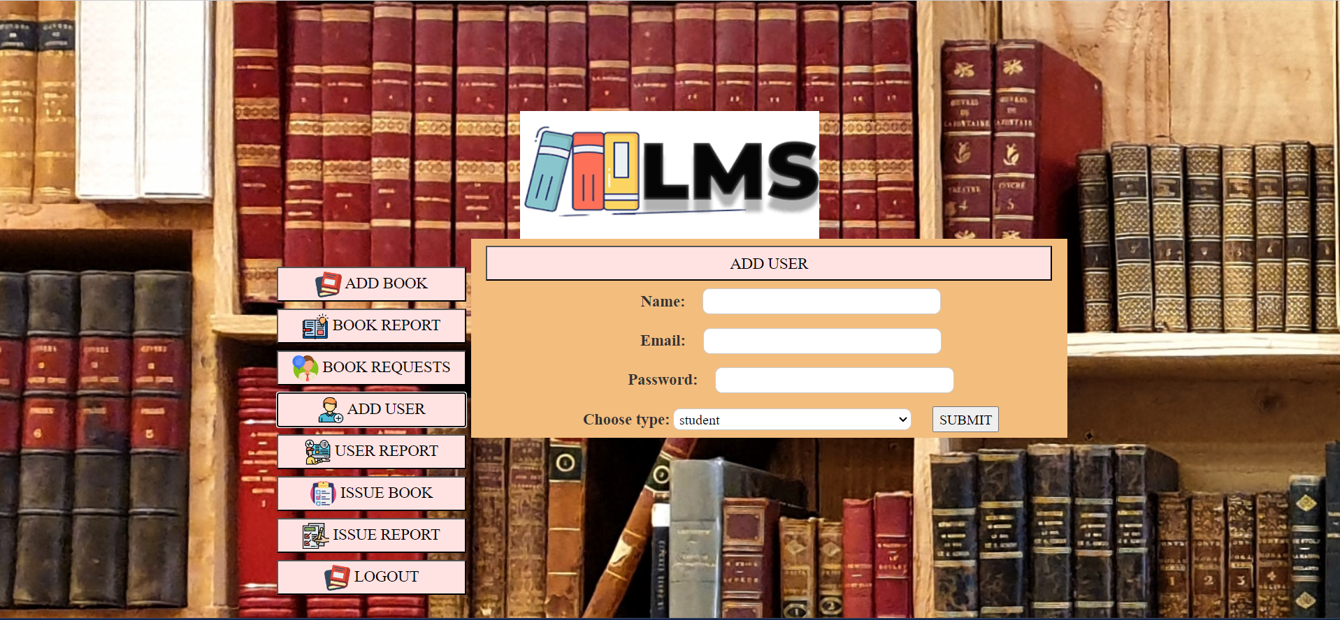
When we click on Add user

Slide 7
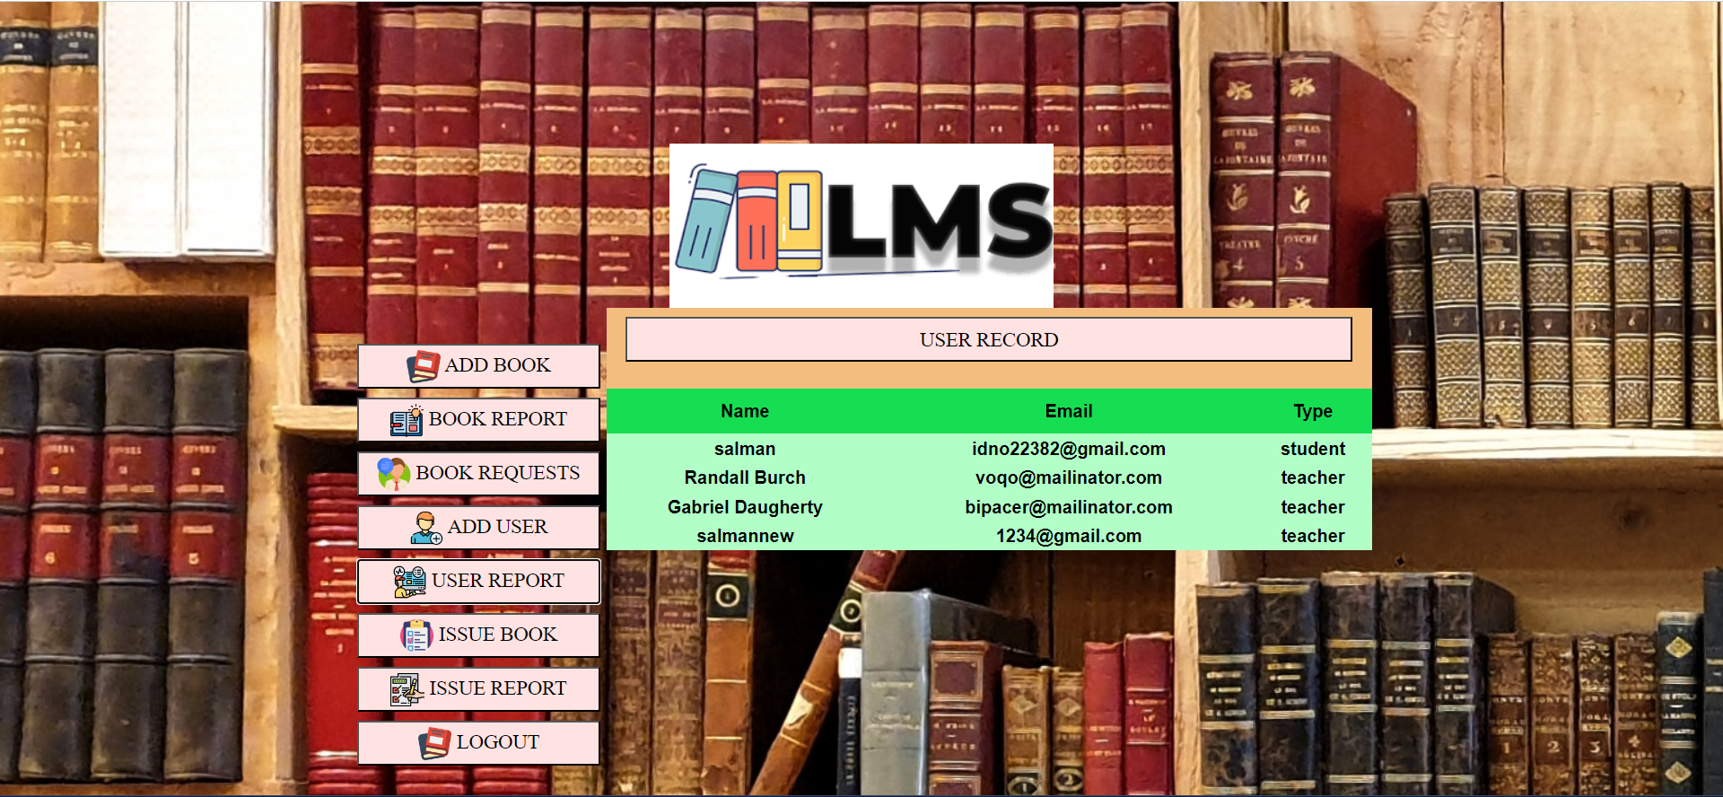
When we click user report

Slide 8
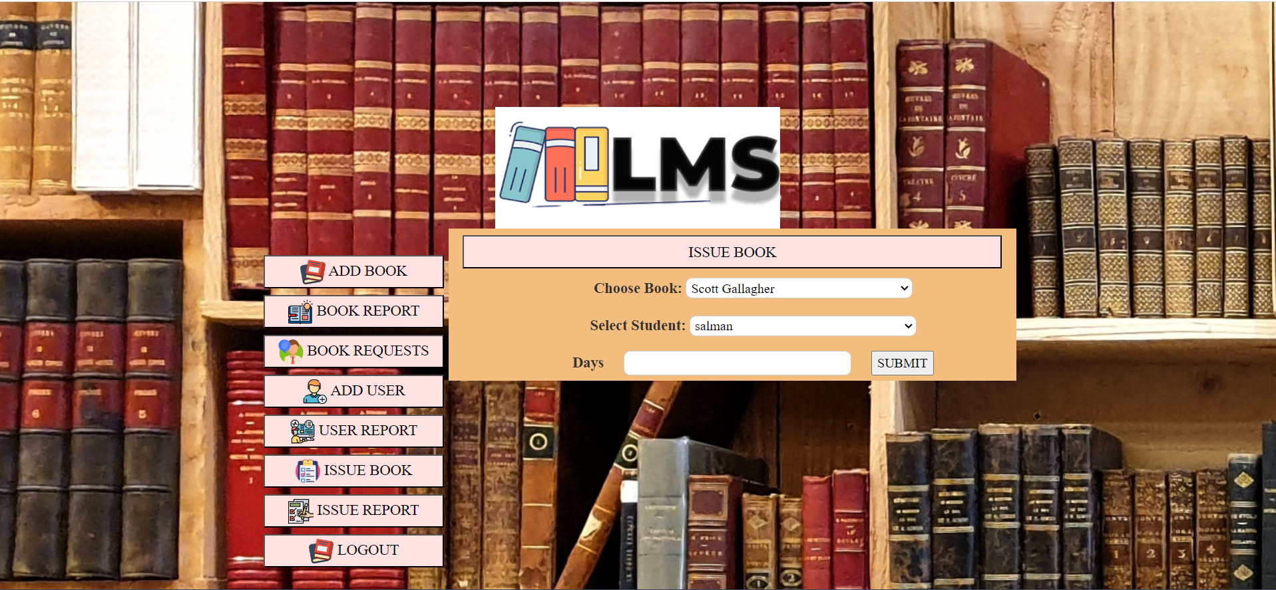
When we click on Issue book

Slide 9
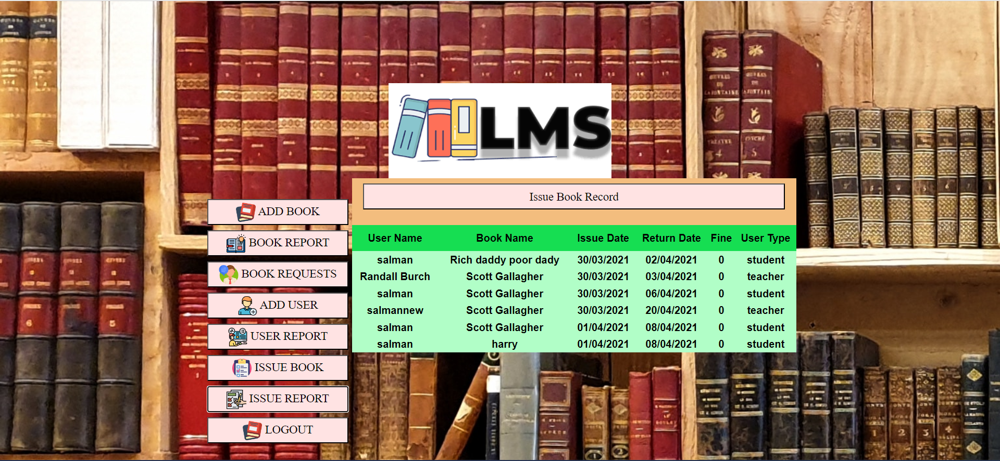
When we click on Issue report

Slide 10
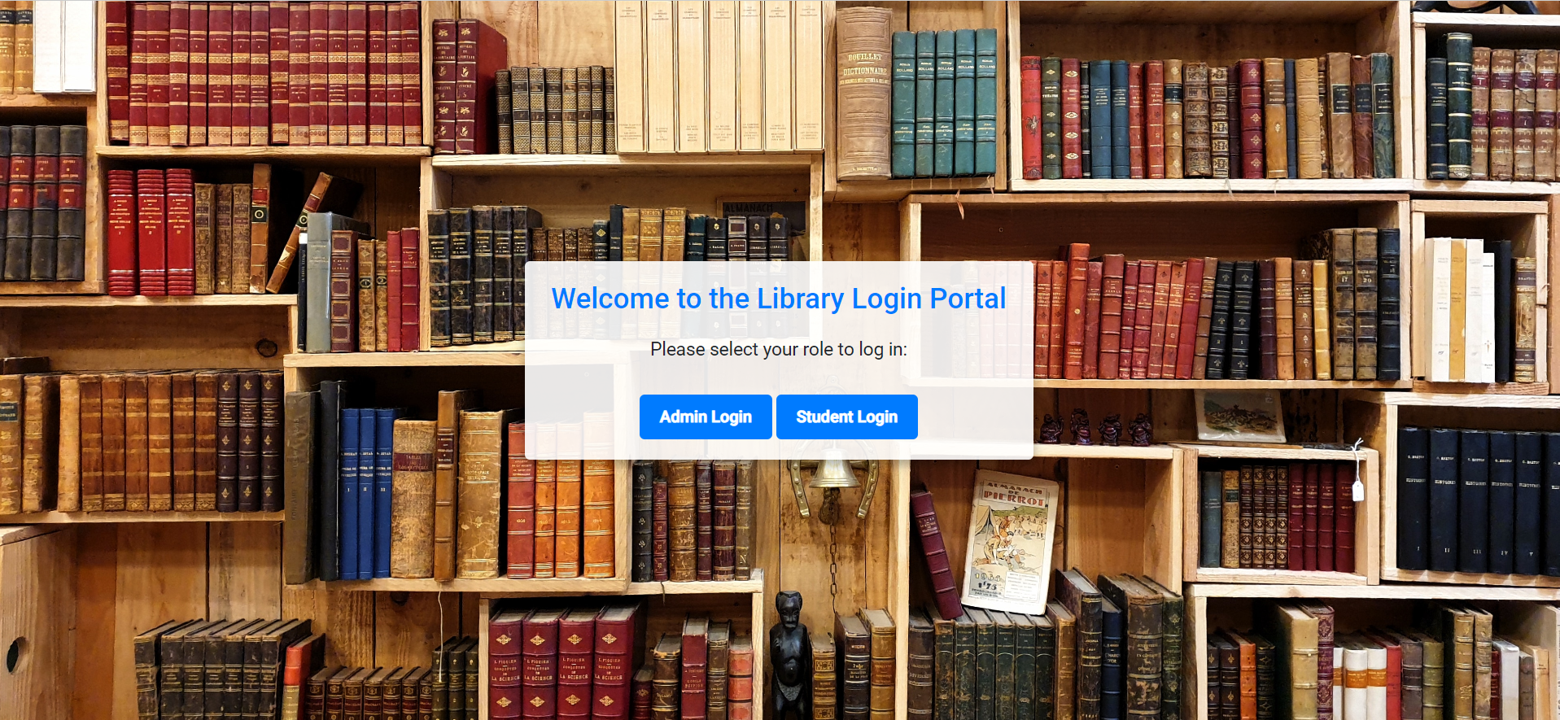
If we click on Logout, then it will revert us back to the landing page

Slide 11
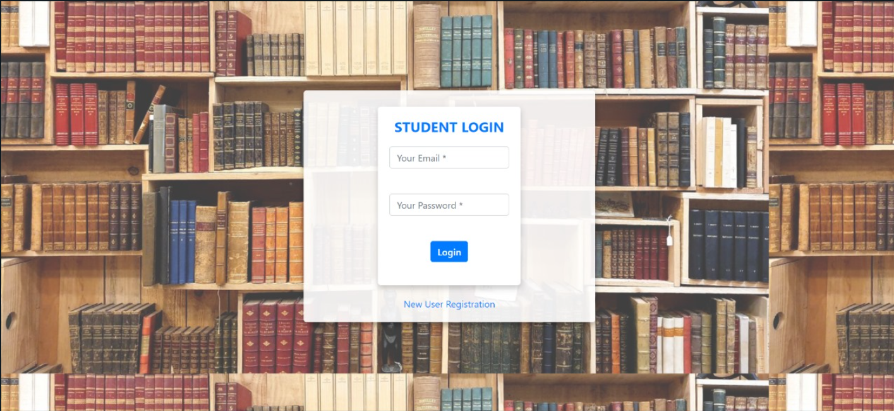
Student Login Page.

Slide 12
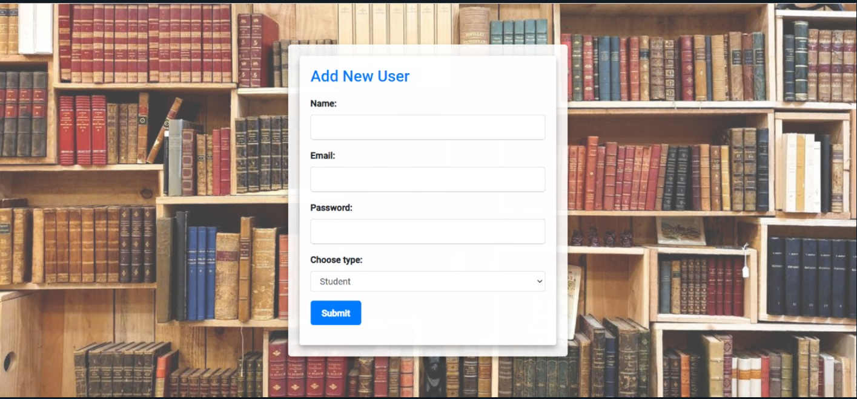
When we will click on new user Registration, this page will open and here we can add new user.

Slide 13
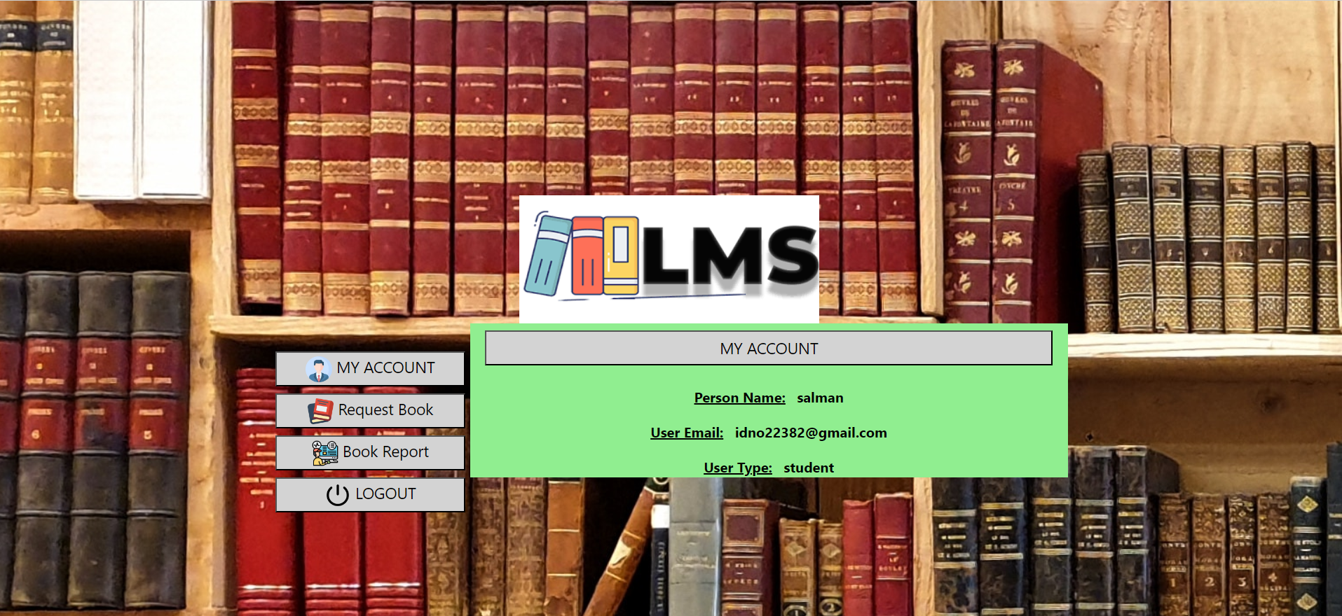
This is Student Interface, and it is showing my account

Slide 14
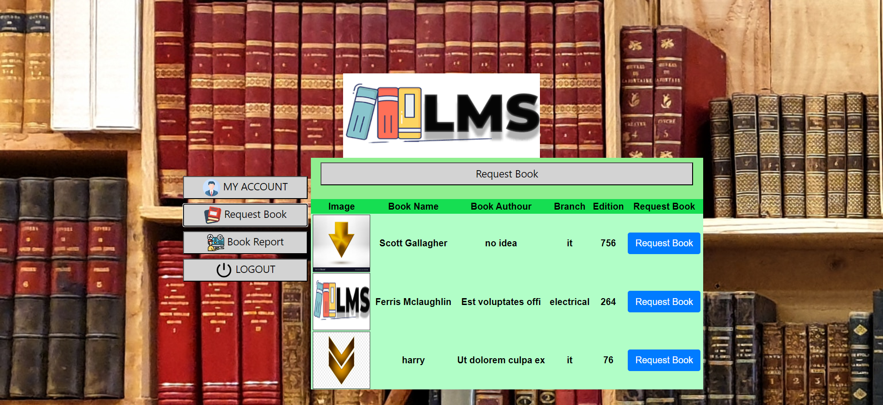
when we click on Request book.

Slide 15
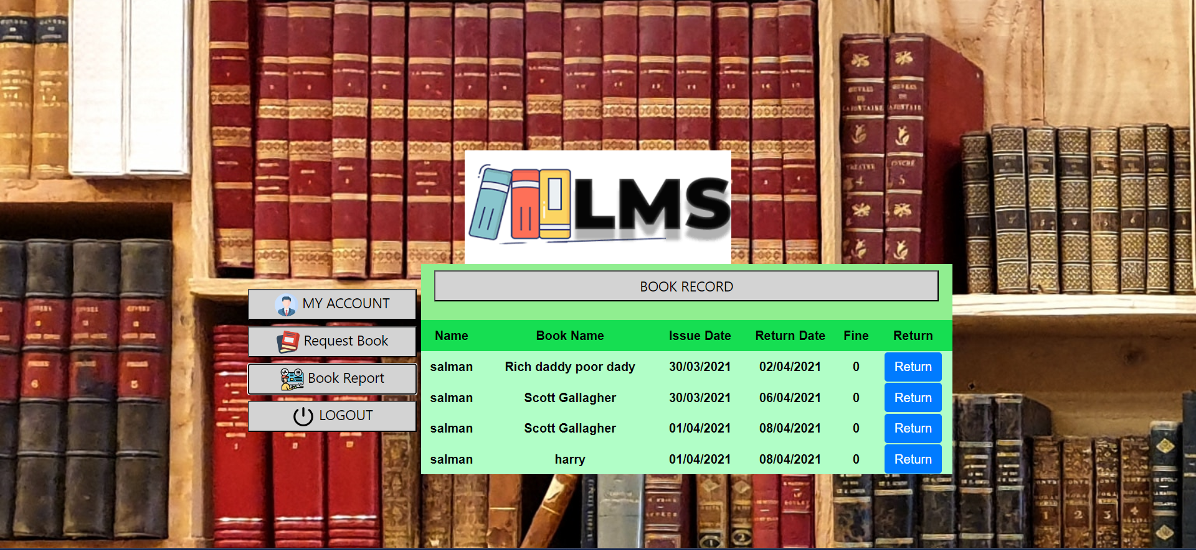
When we click on book Report.

